Slide 1
A2.3.3
Packet Switching
How data travels across a network
🎯 Learning Objective
Explain how packet switching is used to send data across a network, including the roles of switches and routers.

Slide 2
⭐ STARTER ACTIVITY ⭐
Choose your level and complete the challenge!
🟢 LEVEL 1
🟡 LEVEL 2
🔴 LEVEL 3
Foundation
Developing
Extended
Match the words to the definitions:
Packet • Header • Payload • Router
1. The actual data being sent (the message)
2. Control information like source/destination
3. A small chunk of data sent across a network
4. A device that connects different networks
Think about sending a letter cut into pieces:
1. Why might you add the recipient's address to each piece?
2. What problem could occur if the pieces arrive out of order?
3. How would you know if a piece was missing?
4. What advantage does splitting the letter give?
Evaluate and analyse:
Compare packet switching to circuit switching (where a dedicated path is reserved for the whole transmission).
What are TWO advantages and ONE disadvantage of packet switching over circuit switching?
When might circuit switching be preferred?

Slide 3
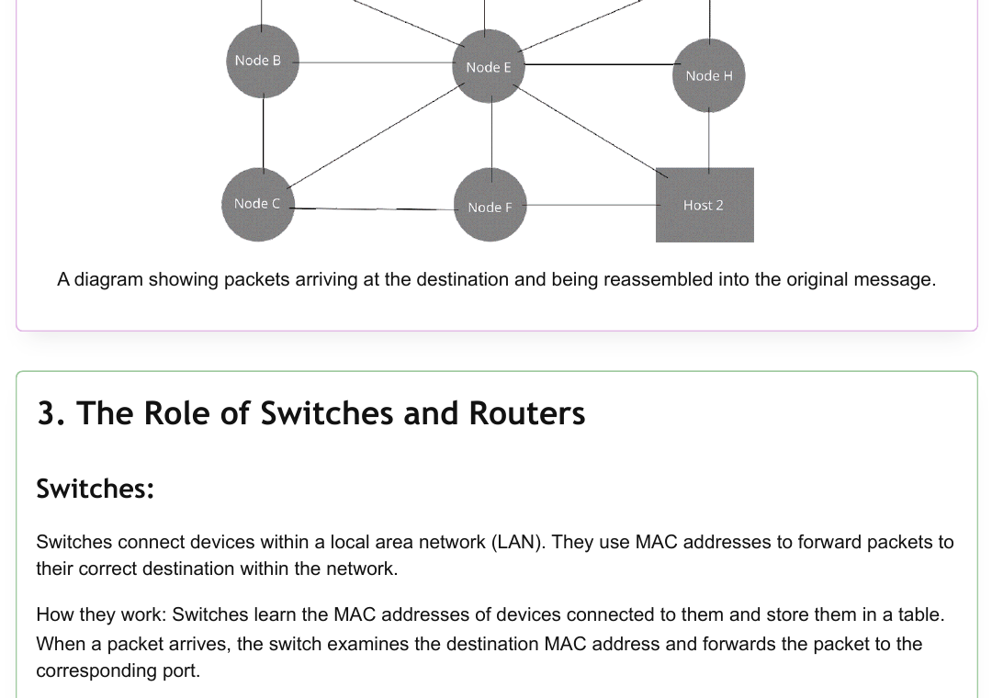
CONCEPT 1 | What is Packet Switching?
How it works
✉️ The Letter Analogy
1. Data is broken into small units called packets
2. Each packet travels independently and may take different routes
3. Packets are reassembled at the destination in correct order
4. Missing or corrupted packets can be retransmitted
Imagine cutting a letter into pieces, placing each in its own envelope with the recipient's address. The pieces travel separately but are reassembled at the destination into the original letter.
Packets are transmitted independently and reassembled using sequence numbers in the header.

Slide 4
📋 ACTIVITY 1 | Put the Packets in Order!
The message 'DATA IS SENT IN PACKETS' has been split into 5 packets that arrived out of order. Number them 1–5 to reassemble the message.
Packet #3
Packet #1
Packet #5
Packet #2
Packet #4
Header Info:
Header Info:
Header Info:
Header Info:
Header Info:
Src: 192.168.1.1
Dst: 10.0.0.1
Src: 192.168.1.1
Dst: 10.0.0.1
Src: 192.168.1.1
Dst: 10.0.0.1
Src: 192.168.1.1
Dst: 10.0.0.1
Src: 192.168.1.1
Dst: 10.0.0.1
Payload:
"SENT IN"
Payload:
"DATA IS"
Payload:
"PACKETS"
Payload:
"IS SENT"
Payload:
"IN PACKETS"
Arrived 1st
Arrived 2nd
Arrived 3rd
Arrived 4th
Arrived 5th
Order: ___
Order: ___
Order: ___
Order: ___
Order: ___
🟢 Level 1: Use the sequence number in the header to order the packets. 🟡 Level 2: What would happen if Packet #3 was lost? 🔴 Level 3: Why is it useful that packets can arrive in a different order to when they were sent?

Slide 5
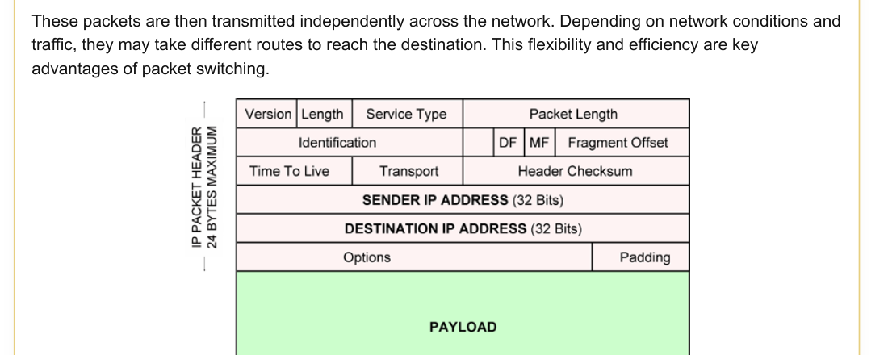
CONCEPT 2 | Anatomy of a Packet
Source IP
Where the packet came from
Destination IP
Where the packet is going
Sequence Number
Packet's position for reassembly
TTL (Time to Live)
PAYLOAD = The actual data (the message being sent)
Prevents packets looping forever
Header Checksum
Error detection for the header
The IPv4 header is up to 24 bytes and contains all the routing and control information needed for delivery.

Slide 6
✏️ ACTIVITY 2 | Label the Packet Header!
Use the word bank below to fill in the labels for each part of the packet.
A
B
C
D
___________
___________
___________
___________
E _______________________ (The actual message data)
📚 Word Bank:
Source IP Address • Destination IP Address • Sequence Number • Header Checksum • Payload
🟢 Level 1: Use the word bank to match the letters A–E. 🟡 Level 2: Explain why the Destination IP is essential in every packet. 🔴 Level 3: The header adds extra bytes to every packet. Is this overhead worth it? Justify your answer.

Slide 7
CONCEPT 3 | Reassembly at the Destination
1
2
3
4
Packets Arrive
Check Sequence Numbers
Detect Missing Packets
Reassemble the Message
All packets reach the destination device, possibly via different routes and in any order.
The destination reads sequence numbers from each packet's header to find the correct order.
If a sequence number is missing, the device requests a retransmission of the lost packet.
Packets are placed in correct sequence order and the original data is reconstructed.
⚠️ Error Handling:
If a packet is missing or corrupted → the destination device requests retransmission of that specific packet only. This is far more efficient than re-sending the entire message, which is what would be required in circuit switching.

Slide 8
🔬 ACTIVITY 3 | What Went Wrong?
A message of 6 packets was sent. Study what arrived at the destination and answer the questions below.
Packets received at destination (in arrival order):
Seq #1
Seq #3
Seq #4
Seq #6
Seq #2
Seq #5
MISSING!
OK
OK
CORRUPTED
OK
OK
Questions:
1. Which packet(s) need to be retransmitted? Give reasons.
2. How does the destination device know packet #5 is missing?
3. After retransmission, in what order should the packets be reassembled?
🟢 L1: Answer Q1 only. 🟡 L2: Answer Q1 & Q2. 🔴 L3: All 3 Qs + suggest how the protocol can reduce errors proactively.

Slide 9
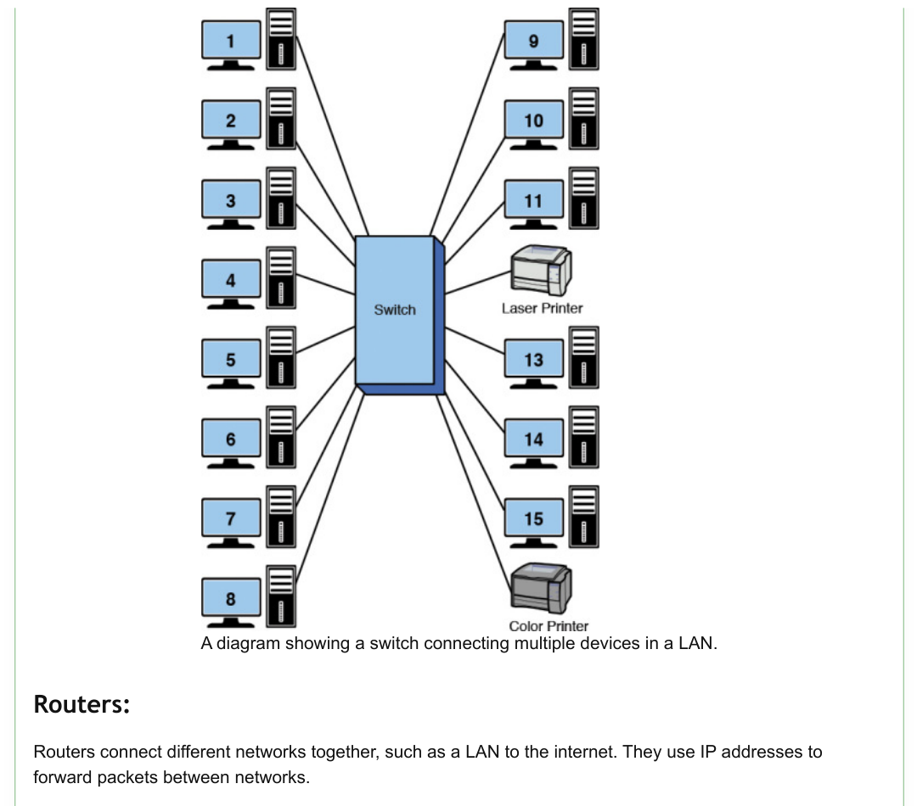
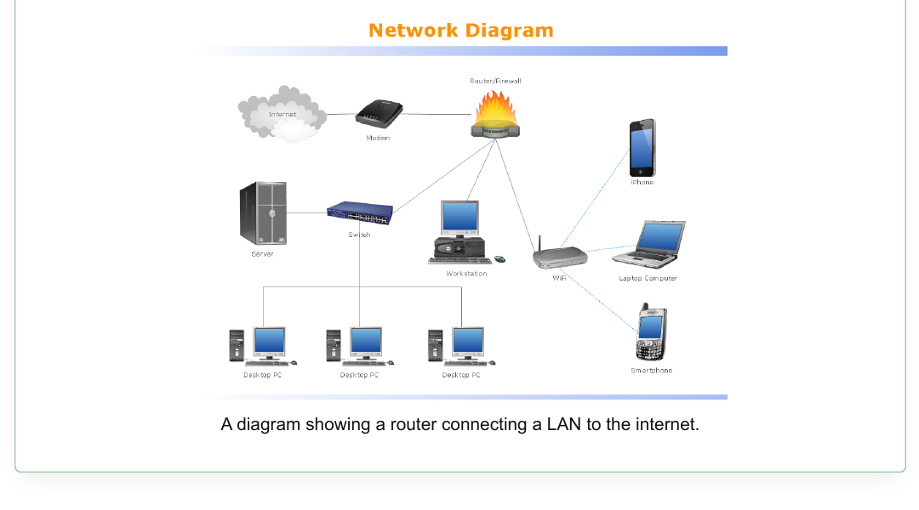
CONCEPT 4 | The Role of Switches & Routers
🔀 SWITCH
🌐 ROUTER
VS
Operates within: Local Area Network (LAN)
Uses: MAC Addresses
How: Learns MAC addresses of connected devices, stores in a table, and forwards packets directly to the right port.
Operates across: Multiple Networks (LAN → Internet)
Uses: IP Addresses
How: Examines destination IP, checks routing table, and forwards each packet along the best available path.

Slide 10
🗂️ ACTIVITY 4 | Switch or Router? Sort the Cards!
Sort each statement into the correct column. Write S (Switch) or R (Router) next to each.
🔀 SWITCH
🌐 ROUTER
Uses MAC addresses
Uses IP addresses
Connects devices within a LAN
Connects a LAN to the Internet
Maintains a routing table
Forwards packets to the correct port within a network
Determines the best path between different networks
Stores device addresses in an internal table
🟢 L1: Sort the 4 easier statements. 🟡 L2: Sort all 8. 🔴 L3: Add 2 of your own statements to each column AND explain why a network needs BOTH a switch AND a router.

Slide 11
🏆 CHALLENGE TASK | Design a Packet Journey
📡 Scenario:
You are sending a 2MB video file from your laptop at home to a friend's computer across the world. The file is broken into 1,500 packets. Describe and annotate the complete journey of these packets from source to destination.
🟢 L1
Describe the Journey
Write 4–5 sentences explaining how one packet travels from your laptop to your friend's computer. Include: segmentation, header info, routing, and reassembly.
🟡 L2
Annotated Diagram
Draw and annotate a network diagram showing: the source device, at least 3 router hops, switches in the LANs at both ends, and the destination device. Label the role of each device.
🔴 L3
Extended Analysis
Evaluate the advantages of packet switching for this video file transfer compared to circuit switching. Consider: network efficiency, fault tolerance, cost, and real-time data challenges. Write a structured argument (min. 200 words).

Slide 12
📝 LESSON SUMMARY | What Have We Learned?
📦
Packet Switching
🗂️
Packet Structure
Data is split into packets, each transmitted independently across the network.
Header (source/dest IP, sequence no., TTL, checksum) + Payload (the actual data).
🔄
Reassembly
🔀
Switches
Sequence numbers allow destination to reorder packets and request retransmission of lost ones.
Forward packets within a LAN using MAC addresses and a stored address table.
🌐
Routers
Forward packets between networks using IP addresses and routing tables.
🎫 EXIT TICKET
On a sticky note, write: (1) One thing you understood well today (2) One thing you are still unsure about (3) In one sentence: what is packet switching?

